Slide 1
5min Cloud Breach
DigitalForensic Track 김태룡

Slide 2
○●○○○○○○○○○○○○
INDEX
01. Breach
02. Cases - Data Breach
03. Cases – Cloud Breach
5min Cloud Breach

Slide 3
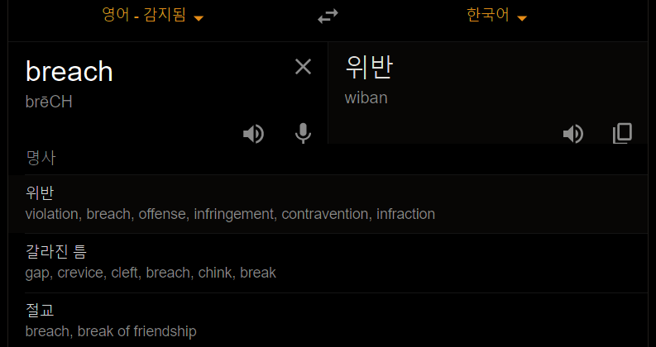
○○●○○○○○○○○○○○
Breach
???
5min Cloud Breach

Slide 4
○○○●○○○○○○○○○○
Breach
Don’t Think About Translation
5min Cloud Breach

Slide 5

○○○○●○○○○○○○○○
Breach
BreachBreachBreachReachReachReachReech
ReechReechLeechLeechLeech
Leech
5min Cloud Breach

Slide 6

○○○○○●○○○○○○○○
Breach
Data Breach
Cloud Breach
5min Cloud Breach

Slide 7
Data in company
○○○○○○●○○○○○○○
Cases – Data Breach
Target | Yahoo | Marriott Internationa | Adult Friend Finder
When | 2013 ~ 2014 | 2014 ~ 2018 | 2016.10
Stolen | 3 Billion user accounts | 500 Million customers | 412 Million accounts
Misconfigured | Spear-phishing | Spear-phishing | Local File Inclusion (LFI)
Attack Scenario | Send phishing mail ▶ Backdoor ▶ DB copy ▶ MD5 crack | Send phishing mail ▶ MimiKatz&RAT(Get user account) ▶ DB Query | Command Injection ▶ Access accounts DB
Detected | FBI | Internal investigation (Not discussed in detail) | Researcher who goes by the handle 1x0123
Response | Advised change password | Engaged leading security experts | Hire FireEye to help with the investigation
Remediated | Change password | WebWatcher Enrollment | Use Salted Hash
https://www.csoonline.com/article/2130877
5min Cloud Breach

Slide 8








Data in company
○○○○○○○●○○○○○○
Cases – Data Breach
(This is just example. It may differ from the actual.)
?
?
IDS
Network
Connection
Fire wall
Database
Internal Server
5min Cloud Breach

Slide 9
Data in cloud service
○○○○○○○○●○○○○○
Cases – Cloud Breach
Target | Instagram (Chtrbox) | Capital One | Autoclerk
When | 2020.05.20. | 2020.07.29. | 2020.09.13.
Stolen | 49 Million records | 0.8 Million Account (1Million GovernmentID) | 1 Million booking reservations (179GB)
Misconfigured | AWS password policy | Network separation | Unsecured Elasticsearch DB
Attack Scenario | Access to DB that none password policy | Access with TOR ▶ Get Access data in EC2 Metadata Service ▶ Breach AWS S3 | Unknwon (Because not discovered yet)
Detected | Security researcher Anurag Sen | Email “There appears to be some leaked s3 data of yours in someone’s github” | vpnMentor
Response | Configuration Vulnerability Fix
Remediated | Instagram API Limit | - | -
https://www.lacework.com/top-cloud-breaches-2019/
5min Cloud Breach

Slide 10

Data in cloud service
○○○○○○○○○●○○○○
Cases – Cloud Breach
Cloud
Configuration
Logging Policy
(Cloud Trail)
Network
Connection
Security Policy
(WAF & Shield)
Hosting
(EC2)
Database
(RDS)
5min Cloud Breach

Slide 11
Data in cloud service
○○○○○○○○○○●○○○
Cases – Cloud Breach
(This is just example. It may differ from the actual.)
Cloud
Configuration
Network
Connection
Logging Policy
(Cloud Trail)
Security Policy
(WAF & Shield)
Hosting
(EC2)
Database
(RDS)
5min Cloud Breach

Slide 12
Data in cloud service
○○○○○○○○○○○●○○
Cases – Cloud Breach
(This is just example. It may differ from the actual.)
Cloud
Configuration
Logging Policy
(Cloud Trail)
Network
Connection
Security Policy
(WAF & Shield)
Hosting
(EC2)
Database
(RDS)
5min Cloud Breach

Slide 13
Data in cloud service
○○○○○○○○○○○○●○
Cases – Cloud Breach
(This is just example. It may differ from the actual.)
Cloud
Configuration
Network
Connection
Logging Policy
(Cloud Trail)
Hosting
(EC2)
Security Policy
(WAF & Shield)
Database
(RDS)
5min Cloud Breach

Slide 14
Thankyou
Image Source : Hackers (Android)

